Slide 1
Advanced Python Programming
Basic Software Architecture
Concepts
Marco Prenassi
Laboratory of Data Engineering, Area Science Park
date

Slide 2
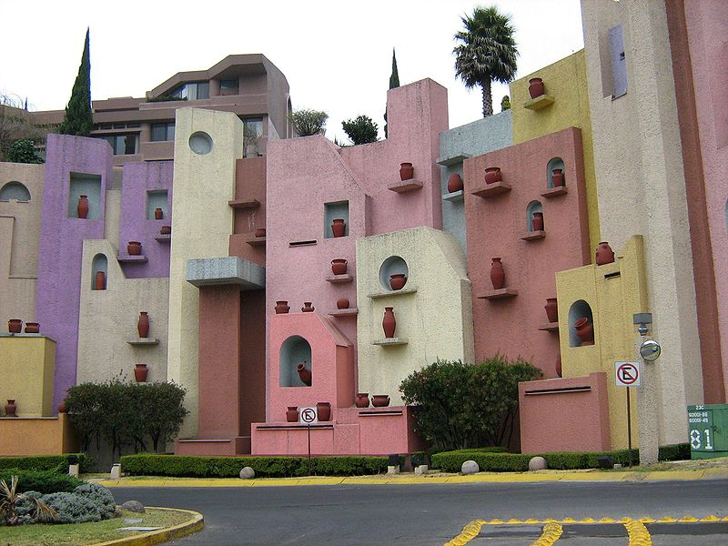
SOFTWARE BASIC ARCHITECURAL CONCEPTS
Mexican architecture, Mexico City, 2008.
author:
Joaquín Martínez Rosado

Slide 3
SOFTWARE LIFE CYCLE
Feasibility study
Requirements analysis
Design
Coding
Test
Maintenance

Slide 4
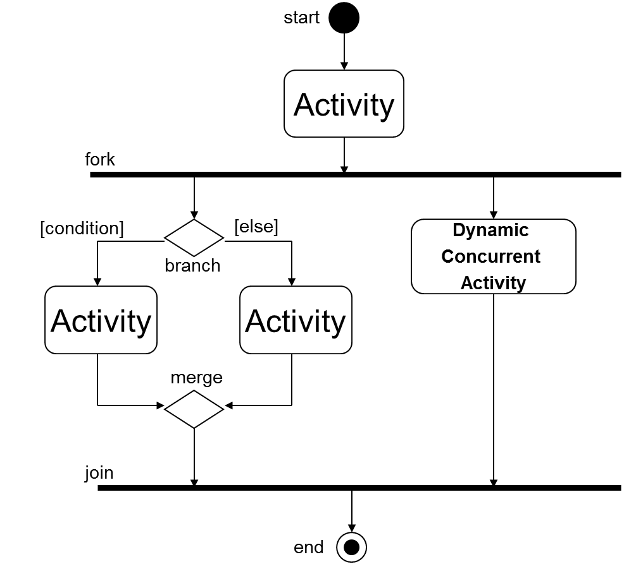
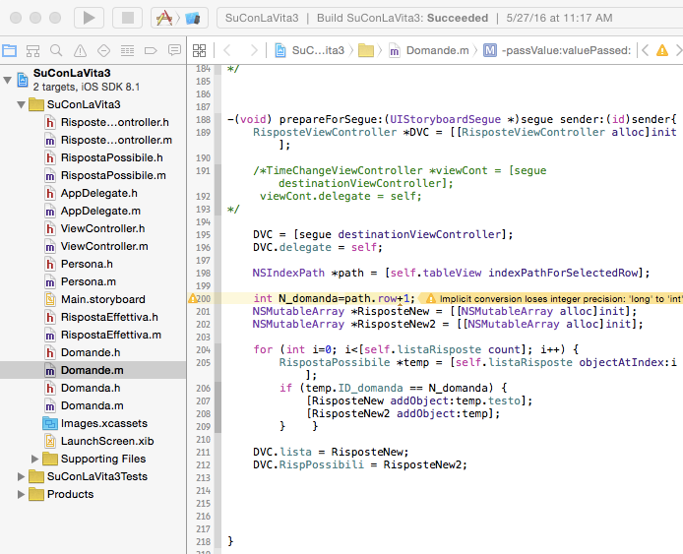
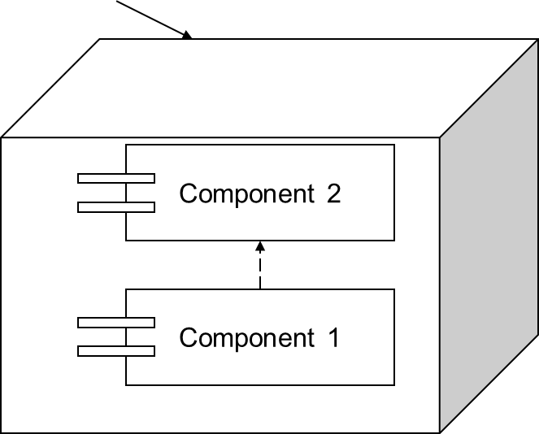
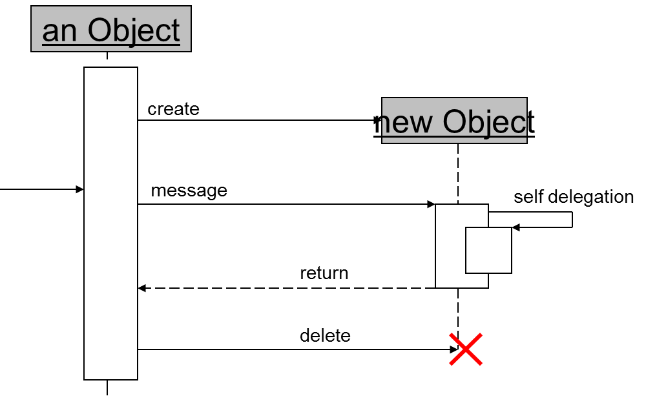
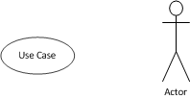
SOFTWARE LIFE CYCLE
SOFTWARE
DESIGN
≠
CODING

Slide 5
SOFTWARE PROPERTIES
 | INTERNAL | EXTERNAL | PRODUCT | PROCESS
CORRECTNESS | X |  | X | X
RELIABILITY |  |  | X
ROBUSTNESS | X |  | X
PERFORMANCE |  |  | X
SCALABILITY |  |  | X
EFFICIENCY | X |  | X | X
USABILITY | X |  | X
VERIFIABILITY | X |  | X | X
MAINTAINABILITY | X |  | X
REUSABILITY |  | X | X
PORTABILITY |  | X | X
COMPREHENSIBILITY |  |  | X | X
INTEROPERABILITY |  |  | X
PRODUCTIVITY |  |  |  | X
TIMELINESS |  |  |  | X
TRANSPARENCY |  | X | X | X

Slide 6
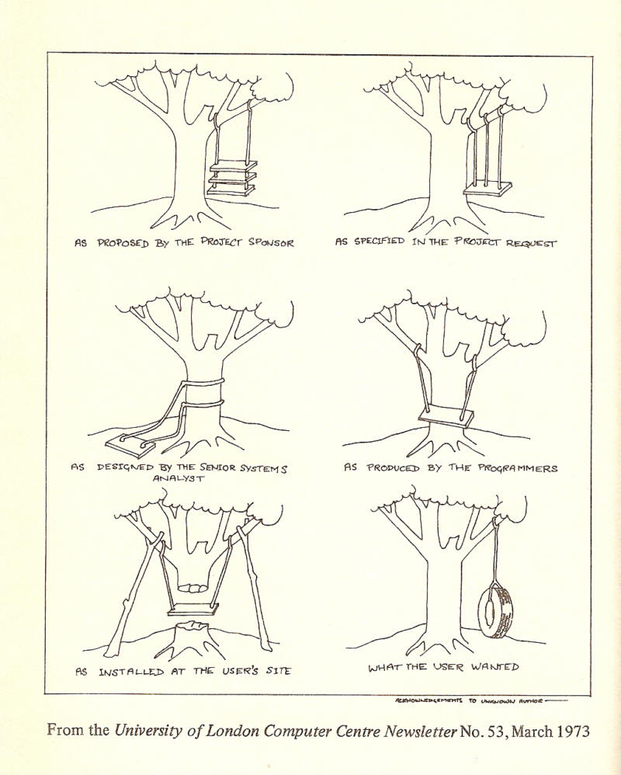

Slide 8










DECOS ARCHITECTURE and DEVELOPMENT
elabFTW
PRP
CDM
app
API
INTERFACE
REST API
DATALAKE+
S3
BUCKETS
REST API
parsing and postprocessing
Jenkins
pipelines
DJANGO ORM
decos_
metadata_db
DIMMT
Home
admin
Home
APP
Wagtail
Database
Routing
Multisite
routing
DIMMT
decos_
webapp_db
easyDMP
Laboratories
app
easyDMP
DECOS WEB APPs

Slide 9
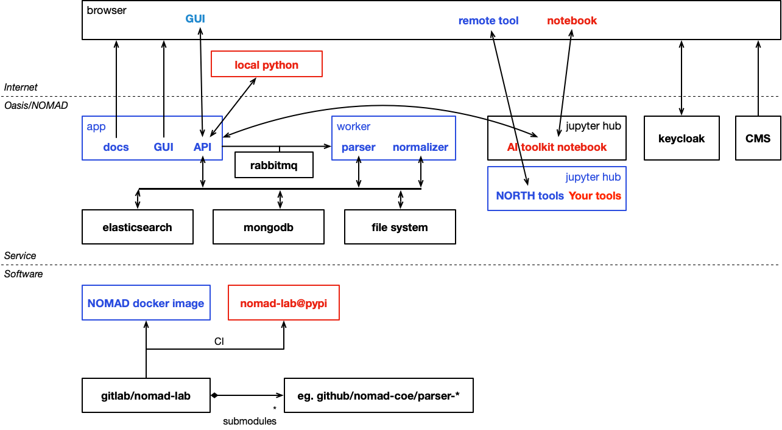
NOMAD OASIS ARCHITECTURE

Slide 10
DECOS DESIGN
Feasibility study
Requirements analysis
Design
Coding
Test
Maintenance
FEASIBILITY STUDY
REQUIREMENT ANALYSIS
DESIGN
CODING
TEST
MAINTENANCE

Slide 11

FEASIBILITY STUDY (an example)
HARDWARE INFRASTRUCTURE
DATA EXCHANGE CAPABILITIES
DATA RETENTION CAPABILITIES
SOLUTION: CONTAINERIZATION AND CI/CD DEVOPS PLAN

Slide 12

REQUIREMENT ANALYSIS
DATA INTEROPERABILITY
SOFTWARE INTEROPERABILITY
RESEARCHER PROCESS
HETEROGENITY OF LABORATORIES
SOLUTION: PROCESS ANALYSIS

Slide 13




REQUIREMENT ANALYSIS
Sample in
Researcher x Instruments
Results

Slide 14
REQUIREMENT ANALYSIS
Description of the sample
Raw data
original data
Post-Processed data
Sample in
Researcher x Instruments
Results

Slide 15
REQUIREMENT ANALYSIS
Data:
Datalake [S3 Bucket]
Description of the sample
Raw data
original data
Post-Processed data
Sample in
Researcher x Instruments
Results

Slide 16
REQUIREMENT ANALYSIS
Planning :
Data Management Plan
Metadata :
easyDMP
easyDMP
elabFTW
easyDMP
Data :
Datalake [S3 Bucket]
Description of the sample
Raw data
original data
Post-Processed data
Sample in
Researcher x Instruments
Results

Slide 17
DESIGN – «First» element
Home
admin
Home
APP
Wagtail
DJANGO ORM
Database
Routing
easyDMP
decos_
webapp_db
easyDMP
DECOS WEB APPs

Slide 18
DESIGN – «Second element»
decos_
metadata_db
PRP
CDM
app
API
INTERFACE
DJANGO ORM

Slide 19
DESIGN – CODING + INTEGRATION TESTS
elabFTW
PRP
CDM
app
API
INTERFACE
DJANGO ORM
decos_
metadata_db
Database
Routing
DIMMT
Home
admin
Home
APP
Wagtail
Multisite
routing
DIMMT
decos_
webapp_db
easyDMP
Laboratories
app
easyDMP
DECOS WEB APPs

Slide 20
MODULAR DEVELOPMENT
elabFTW
API interface
API interface
elabFTW
PRP
CDM
app
API
INTERFACE
DATALAKE+
S3
BUCKETS
parsing and postprocessing
Jenkins
pipelines
DJANGO ORM
decos_
metadata_db
DIMMT
Home
admin
Home
APP
Wagtail
Database
Routing
Multisite
routing
EPIRO
decos_
webapp_db
easyDMP
Laboratories
app
easyDMP
DECOS WEB APPs

Slide 21
CONTINOUS DEVELOPMENT (AND INTEGRATION)
Planning :
EPIRO
Data Management Plan with easyDMP
Metadata :
EPIRO
EPIRO
easyDMP
easyDMP
elabFTW
easyDMP
Data :
Datalake [S3 Bucket]
Description of the sample
Raw data
original data
Post-Processed data
Proposal
Step
Sample in
Researcher x Instruments
Results
External User
*EPIRO: Digital Infrastructure Management and Monitoring Tool

Slide 22
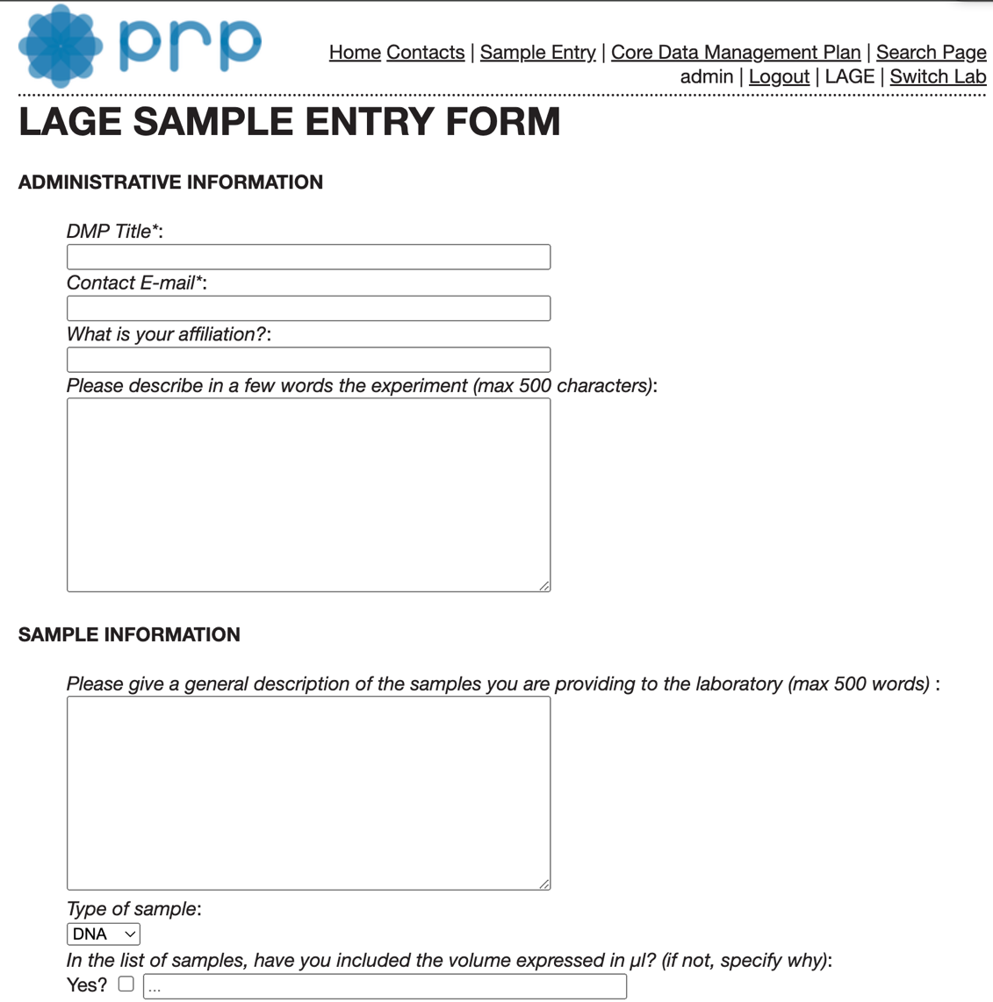
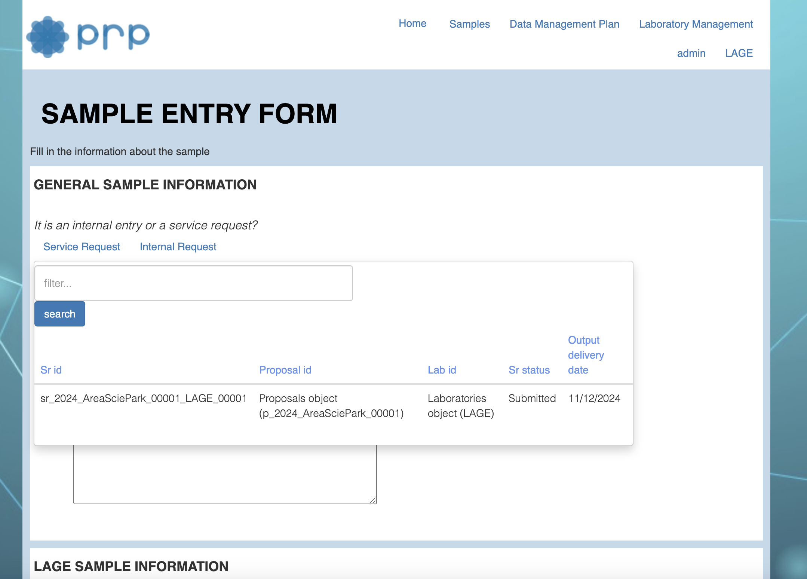
CONTINOUS DEVELOPMENT (AND INTEGRATION)

Slide 23
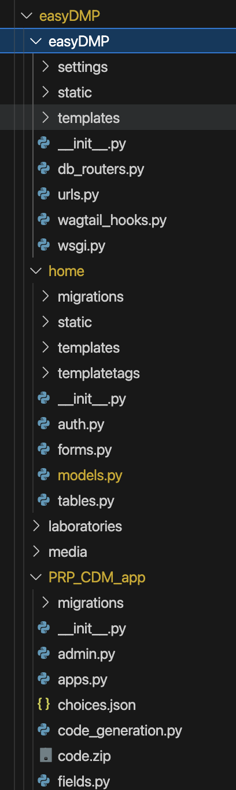
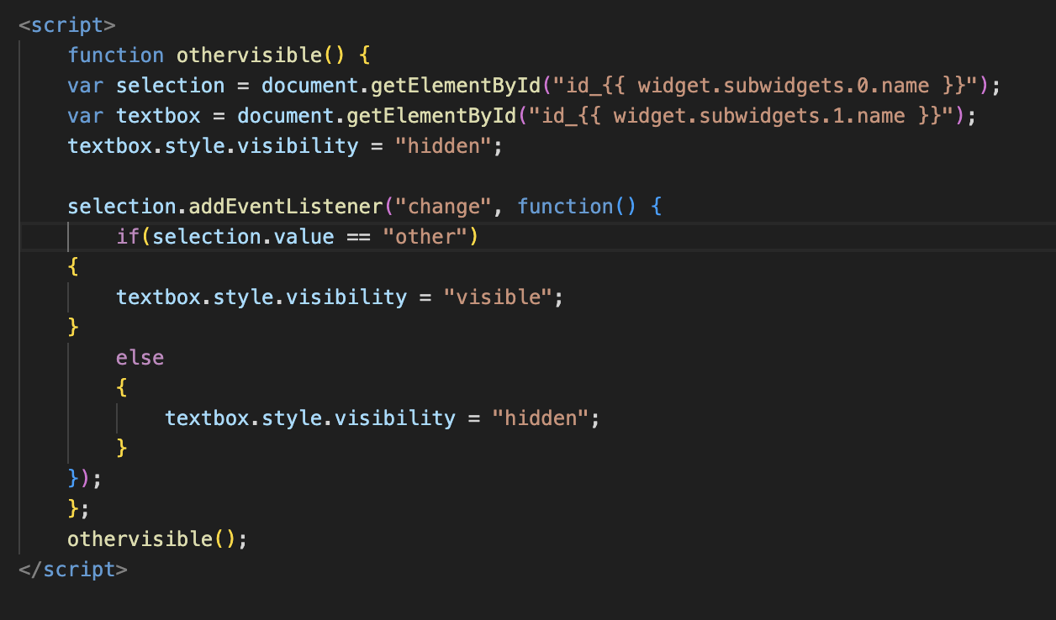
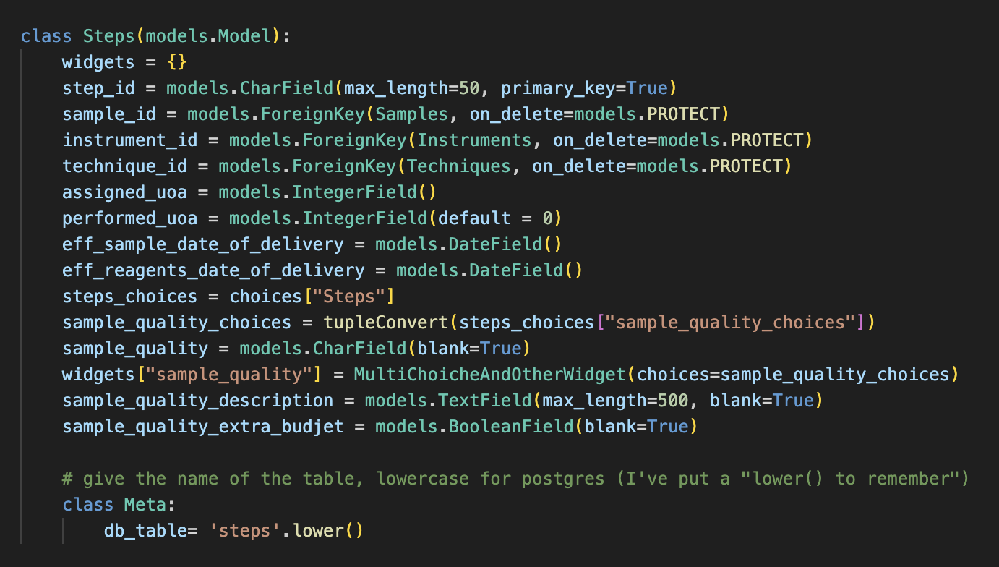
DEALING WITH THE RISE OF COMPLEXITY IN OUR SYSTEM

Slide 24
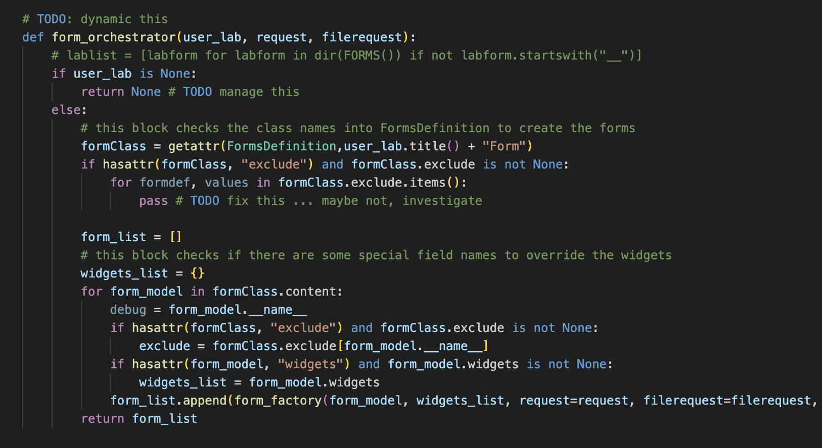
DEALING WITH THE RISE OF COMPLEXITY IN OUR SYSTEM

Slide 25
DEALING WITH THE RISE OF COMPLEXITY IN OUR SYSTEM
TAKE TIME TO ABSTRACT
TAKE TIME ON YOUR INTERFACES
TAKE TIME ON THE USER + MACHINE PROCESS

Slide 26
Thank you

